Slide 1
Why we test?

Slide 2
To not be afraid of code changes

Slide 3
It facilitates change (refactoring)

Slide 4
Learning unit testing doesn’t stop at mastering the technical bits of it, such as your favorite test framework, mocking library, and so on. There’s much more to unit testing than the act of writing tests. You always have to strive to achieve the best return on the time you invest in unit testing, minimizing the effort you put into tests and maximizing the benefits they provide. Achieving both things isn’t an easy task.
It’s fascinating to watch projects that have achieved this balance: they grow effortlessly, don’t require much maintenance, and can quickly adapt to their customers' ever-changing needs. It’s equally frustrating to see projects that failed to do so. Despite all the effort and an impressive number of unit tests, such projects drag on slowly, with lots of bugs and upkeep costs.
That’s the difference between various unit testing techniques. Some yield great outcomes and help maintain software quality. Others don’t: they result in tests that don’t contribute much, break often, and require a lot of maintenance in general.

Slide 5
Current state of unit testing
For the past two decades, there’s been a push toward adopting unit testing. The push has been so successful that unit testing is now considered mandatory in most companies. Most programmers practice unit testing and understand its importance. There’s no longer any dispute as to whether you should do it. Unless you’re working on a throw-away project, the answer is: you do.

Slide 6
But, as with all new technologies, unit testing continues to evolve. The discussion has shifted from "Should we write unit tests?" to "What does it mean to write good unit tests?" This is where the main confusion still lies.
You can see the results of this confusion in software projects. Many projects have automated tests; they may even have a lot of them. But the existence of those tests often doesn’t provide the results the developers hope for. It can still take programmers a lot of effort to make progress in such projects. New features take forever to implement, new bugs constantly appear in the already implemented and accepted functionality, and the unit tests that are supposed to help don’t seem to mitigate this situation at all. They can even make it worse.

Slide 7
The goal of unit testing
Before taking a deep dive into the topic of unit testing, let’s step back and consider the goal that unit testing helps you to achieve. It’s often said that unit testing practices lead to a better design. And it’s true: the necessity to write unit tests for a code base normally leads to a better design. But that’s not the main goal of unit testing; it’s merely a pleasant side effect.
The ability to unit test a piece of code is a nice litmus test, but it only works in one direction. It’s a good negative indicator — it points out poor-quality code with relatively high accuracy. If you find that code is hard to unit test, it’s a strong sign that the code needs improvement. The poor quality usually manifests itself in tight coupling, which means different pieces of production code are not decoupled from each other enough, and it’s hard to test them separately.
Unfortunately, the ability to unit test a piece of code is a bad positive indicator. The fact that you can easily unit test your code base doesn’t necessarily mean it’s of good quality. The project can be a disaster even when it exhibits a high degree of decoupling.

Slide 8
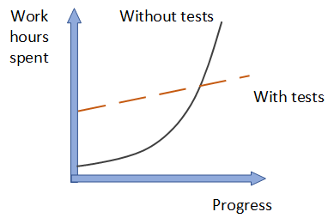
What is the goal of unit testing, then? The goal is to enable sustainable growth of the software project. The term sustainable is key. It’s quite easy to grow a project, especially when you start from scratch. It’s much harder to sustain this growth over time.
Figure 1.1 shows the growth dynamic of a typical project without tests. You start off quickly because there’s nothing dragging you down. No bad architectural decisions have been made yet, and there isn’t any existing code to worry about. As time goes by, however, you have to put in more and more hours to make the same amount of progress you showed at the beginning. Eventually, the development speed slows down significantly, sometimes even to the point when you can’t make any progress whatsoever.

Slide 9
This phenomenon of quickly decreasing development speed is also known as software entropy. Entropy (the amount of disorder in a system) is a mathematical and scientific concept that can also apply to software systems. (If you’re interested in the math and science of entropy, look up the second law of thermodynamics.)
In software, entropy manifests in the form of code that tends to deteriorate. Each time you change something in a code base, the amount of disorder in it, or entropy, increases. If left without proper care, such as constant cleaning and refactoring, the system becomes increasingly complex and disorganized. Fixing one bug introduces more bugs, and modifying one part of the software breaks several others — it’s like a domino effect. Eventually, the code base becomes unreliable. And worst of all, it’s hard to bring it back to stability.

Slide 10
Tests help overturn this tendency. They act as a safety net — a tool that provides insurance against a vast majority of regressions. Tests help make sure the existing functionality works, even after you introduce new features or refactor the code to better fit new requirements.
The downside here is that tests require initial, sometimes significant, effort. But they pay for themselves in the long run by helping the project to grow in the later stages. Software development without the help of tests that constantly verify the code base simply doesn’t scale.
Sustainability and scalability are the keys. They allow you to maintain development speed in the long run.

Slide 11
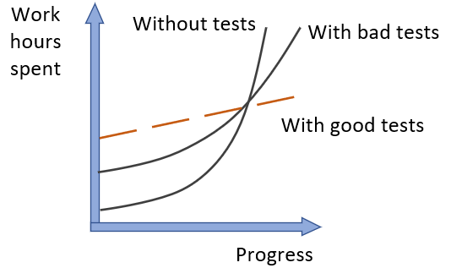
What makes a good or bad test?
As shown in figure 1.2, bad tests do help to slow down code deterioration at the beginning: the decline in development speed is less prominent compared to the situation with no tests at all. But nothing really changes in the grand scheme of things. It might take longer for such a project to enter the stagnation phase, but stagnation is still inevitable.
It’s easy to create tests whose net value is close to zero or even is negative due to high maintenance costs. To enable sustainable project growth, you have to exclusively focus on high-quality tests — those are the only type of tests that are worth keeping in the test suite.

Slide 12
Remember, not all tests are created equal. Some of them are valuable and contribute a lot to overall software quality. Others don’t. They raise false alarms, don’t help you catch regression errors, and are slow and difficult to maintain. It’s easy to fall into the trap of writing unit tests for the sake of unit testing without a clear picture of whether it helps the project.
You can’t achieve the goal of unit testing by just throwing more tests at the project. You need to consider both the test’s value and its upkeep cost. The cost component is determined by the amount of time spent on various activities:
Refactoring the test when you refactor the underlying code
Running the test on each code change
Dealing with false alarms raised by the test
Spending time reading the test when you’re trying to understand how the underlying code behaves
It’s easy to create tests whose net value is close to zero or even is negative due to high maintenance costs. To enable sustainable project growth, you have to exclusively focus on high-quality tests — those are the only type of tests that are worth keeping in the test suite.

Slide 13
PRODUCTION CODE VS. TEST CODE
People often think production code and test code are different. Tests are assumed to be an addition to production code that has no cost of ownership. By extension, people often believe that the more tests, the better.
This isn’t the case. Code is a liability, not an asset. The more code you introduce, the more you extend the surface area for potential bugs in your software, and the higher the project’s upkeep cost. It’s always better to solve problems with as little code as possible.
Tests are code, too. You should view them as the part of your code base that aims at solving a particular problem: ensuring the application’s correctness. Unit tests, just like any other code, are also vulnerable to bugs and require maintenance.

Slide 14
Using coverage metrics to measure test suite quality
There are different types of coverage metrics, and they’re often used to assess the quality of a test suite. The common belief is that the higher the coverage number, the better.
Unfortunately, it’s not that simple, and coverage metrics, while providing valuable feedback, can’t be used to effectively measure the quality of a test suite. It’s the same situation as with the ability to unit test the code: coverage metrics are a good negative indicator but a bad positive one.
If a metric shows that there’s too little coverage in your code base — say, only 10% — that’s a good indication that you are not testing enough. But the reverse isn’t true: even 100% coverage isn’t a guarantee that you have a good-quality test suite. A test suite that provides high coverage can still be of poor quality.

Slide 15
Understanding the code-coverage metric
Code coverage (test coverage) = Lines of code executed / Total number of lines
Notes:
THE CODE COVERAGE (TEST COVERAGE) METRIC IS CALCULATED AS THE RATIO BETWEEN THE NUMBER OF CODE LINES EXECUTED BY THE TEST SUITE AND THE TOTAL NUMBER OF LINES IN THE PRODUCTION CODE BASE.

Slide 16
Tested 3/4 lines = > Line coverage = 75%
Tested 2/2 lines = > Line coverage = 100%
Notes:
It’s easy to calculate the code coverage here. The total number of lines in the method is five (curly braces count, too). The number of lines executed by the test is four — the test goes through all the code lines except for the return true statement. This gives us 4/5 = 0.8 = 80% code coverage.
Does the code-coverage number change? Yes, it does. Because the test now exercises all three lines of code (the return statement plus two curly braces), the code coverage increases to 100%.
But did I improve the test suite with this refactoring? Of course not. I just shuffled the code inside the method. The test still verifies the same number of possible outcomes.
This simple example shows how easy it is to game the coverage numbers. The more compact your code is, the better the test coverage metric becomes, because it only accounts for the raw line numbers. At the same time, squashing more code into less space doesn’t (and shouldn’t) change the value of the test suite or the maintainability of the underlying code base.

Slide 17
Understanding the branch coverage metric
Branch coverage = Branches traversed / Total number of branches
Notes:
THE BRANCH METRIC IS CALCULATED AS THE RATIO OF THE NUMBER OF CODE BRANCHES EXERCISED BY THE TEST SUITE AND THE TOTAL NUMBER OF BRANCHES IN THE PRODUCTION CODE BASE.

Slide 18
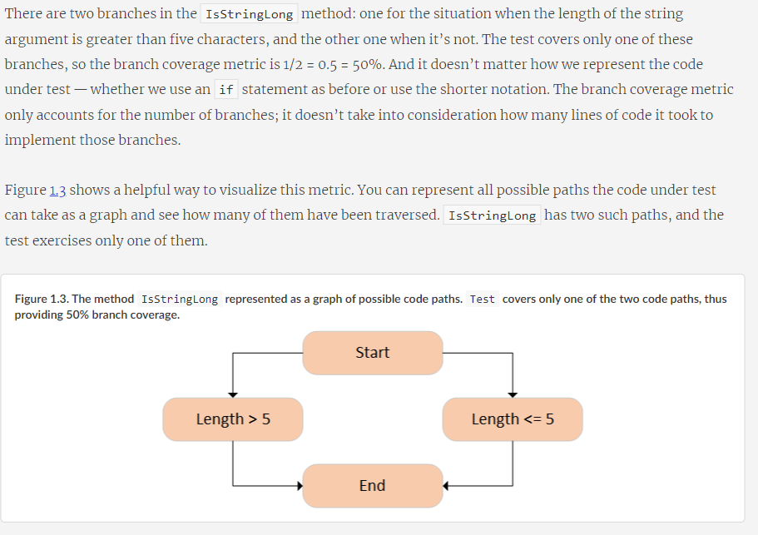

Slide 19
Problems with coverage metrics
Although the branch coverage metric yields better results than code coverage, you still can’t rely on either of them to determine the quality of your test suite, for two reasons:
You can’t guarantee that the test verifies all the possible outcomes of the system under test.
No coverage metric can take into account code paths in external libraries.
Let’s look more closely at each of these reasons.

Slide 20
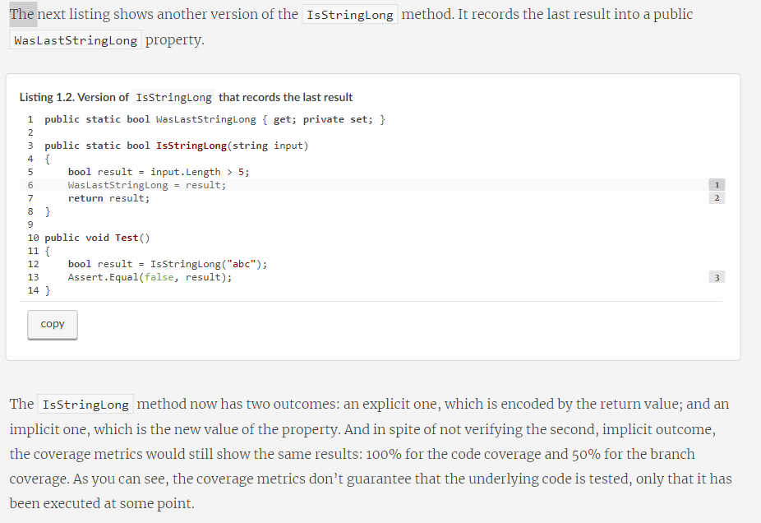
Notes:
For the code paths to be actually tested and not just exercised, your unit tests must have appropriate assertions. In other words, you need to check that the outcome the system under test produces is the exact outcome you expect it to produce. Moreover, this outcome may have several components; and for the coverage metrics to be meaningful, you need to verify all of them.
The IsStringLong method now has two outcomes: an explicit one, which is encoded by the return value; and an implicit one, which is the new value of the property. And in spite of not verifying the second, implicit outcome, the coverage metrics would still show the same results: 100% for the code coverage and 50% for the branch coverage. As you can see, the coverage metrics don’t guarantee that the underlying code is tested, only that it has been executed at some point.

Slide 21
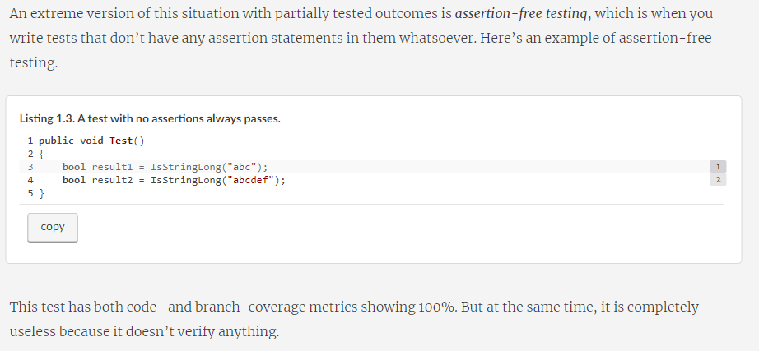

Slide 22
Aiming at a particular coverage number
At this point, I hope you can see that relying on coverage metrics to determine the quality of your test suite is not enough. It can also lead to dangerous territory if you start making a specific coverage number a target, be it 100%, 90%, or even a moderate 70%. The best way to view a coverage metric is as an indicator, not a goal in and of itself.
Think of a patient in a hospital. Their high temperature might indicate a fever and is a helpful observation. But the hospital shouldn’t make the proper temperature of this patient a goal to target by any means necessary. Otherwise, the hospital might end up with the quick and "efficient" solution of installing an air conditioner next to the patient and regulating their temperature by adjusting the amount of cold air flowing onto their skin. Of course, this approach doesn’t make any sense.
Likewise, targeting a specific coverage number creates a perverse incentive that goes against the goal of unit testing. Instead of focusing on testing the things that matter, people start to seek ways to attain this artificial target. Proper unit testing is difficult enough already. Imposing a mandatory coverage number only distracts developers from being mindful about what they test, and makes proper unit testing even harder to achieve.

Slide 23
I’ve spent most of this chapter discussing improper ways to measure the quality of a test suite: using coverage metrics. What about a proper way? How should you measure your test suite’s quality? The only reliable way is to evaluate each test in the suite individually, one by one. Of course, you don’t have to evaluate all of them at once; that could be quite a large undertaking and require significant upfront effort. You can perform this evaluation gradually. The point is that there’s no automated way to see how good your test suite is. You have to apply your personal judgment.

Slide 24
A successful test suite has the following properties
It’s integrated into the development cycle.
It targets only the most important parts of your code base.
It provides maximum value with minimum maintenance costs.
Notes:
It’s integrated into the development cycle
The only point in having automated tests is if you constantly use them. All tests should be integrated into the development cycle. Ideally, you should execute them on every code change, even the smallest one.

Slide 25
It’s integrated into the development cycle
The only point in having automated tests is if you constantly use them. All tests should be integrated into the development cycle. Ideally, you should execute them on every code change, even the smallest one.

Slide 26
It targets only the most important parts of your code base
Just as all tests are not created equal, not all parts of your code base are worth the same attention in terms of unit testing. The value the tests provide is not only in how those tests themselves are structured, but also in the code they verify.
It’s important to direct your unit testing efforts to the most critical parts of the system and verify the others only briefly or indirectly. In most applications, the most important part is the part that contains business logic—the domain model.^{[1]} Testing business logic gives you the best return on your time investment.

Slide 27
All other parts can be divided into three categories:
Infrastructure code
External services and dependencies, such as the database and third-party systems
Code that glues everything together
Notes:
Some of these other parts may still need thorough unit testing, though. For example, the infrastructure code may contain complex and important algorithms, so it would make sense to cover them with a lot of tests, too. But in general, most of your attention should be spent on the domain model.
Some of your tests, such as integration tests, can go beyond the domain model and verify how the system works as a whole, including the noncritical parts of the code base. And that’s fine. But the focus should remain on the domain model.
Note that in order to follow this guideline, you should isolate the domain model from the non-essential parts of the code base. You have to keep the domain model separated from all other application concerns so you can focus your unit testing efforts on that domain model exclusively. We talk about all this in detail in part 2 of the book.

Slide 28
What is a unit test?
These views are known as the classical and the London schools of unit testing. The classical school is called “classical” because it’s how everyone originally approached unit testing and test-driven development. The London school takes root in the programming community in London. The discussion in this chapter about the differences between the classical and London styles lays the foundation for chapter 5, where I cover the topic of mocks and test fragility in detail.
Let’s start by defining a unit test, with all due caveats and subtleties. This definition is the key to the difference between the classical and London schools

Slide 29
The definition of “unit test”
There are a lot of definitions of a unit test. Stripped of their non-essential bits, the definitions all have the following three most important attributes. A unit test is an automated test that
Verifies a small piece of code (also known as a unit),
Does it quickly,
And does it in an isolated manner.
Notes:
The first two attributes here are pretty non-controversial. There might be some dispute as to what exactly constitutes a fast unit test because it’s a highly subjective measure. But overall, it’s not that important. If your test suite’s execution time is good enough for you, it means your tests are quick enough.

Slide 30
THE CLASSICAL AND LONDON SCHOOLS OF UNIT TESTING
The classical approach is also referred to as the Detroit and, sometimes, the classicist approach to unit testing. Probably the most canonical book on the classical school is the one by Kent Beck: Test-Driven Development: By Example (Addison-Wesley Professional, 2002).
The London style is sometimes referred to as mockist. Although the term mockist is widespread, people who adhere to this style of unit testing generally don’t like it, so I call it the London style throughout this book. The most prominent proponents of this approach are Steve Freeman and Nat Pryce. I recommend their book, Growing Object-Oriented Software, Guided by Tests (Addison-Wesley Professional, 2009), as a good source on this subject.

Slide 31
The isolation issue: The London take
What does it mean to verify a piece of code—a unit—in an isolated manner? The London school describes it as isolating the system under test from its collaborators. It means if a class has a dependency on another class, or several classes, you need to replace all such dependencies with test doubles. This way, you can focus on the class under test exclusively by separating its behavior from any external influence.
Notes:
DEFINITION
A test double is an object that looks and behaves like its release-intended counterpart but is actually a simplified version that reduces the complexity and facilitates testing. This term was introduced by Gerard Meszaros in his book, xUnit Test Patterns: Refactoring Test Code (Addison-Wesley, 2007). The name itself comes from the notion of a stunt double in movies.

Slide 32
Notes:
One benefit of this approach is that if the test fails, you know for sure which part of the code base is broken: it’s the system under test. There could be no other suspects, because all of the class’s neighbors are replaced with the test doubles.
Another benefit is the ability to split the object graph—the web of communicating classes solving the same problem. This web may become quite complicated: every class in it may have several immediate dependencies, each of which relies on dependencies of their own, and so on. Classes may even introduce circular dependencies, where the chain of dependency eventually comes back to where it started.
Trying to test such an interconnected code base is hard without test doubles. Pretty much the only choice you are left with is re-creating the full object graph in the test, which might not be a feasible task if the number of classes in it is too high.
With test doubles, you can put a stop to this. You can substitute the immediate dependencies of a class; and, by extension, you don’t have to deal with the dependencies of those dependencies, and so on down the recursion path. You are effectively breaking up the graph—and that can significantly reduce the amount of preparations you have to do in a unit test.

Slide 33
Isolating the class under test from its dependencies helps establish a simple test suite structure: one class with tests for each class in the production code.
Notes:
And let’s not forget another small but pleasant side benefit of this approach to unit test isolation: it allows you to introduce a project-wide guideline of testing only one class at a time, which establishes a simple structure in the whole unit test suite. You no longer have to think much about how to cover your code base with tests. Have a class? Create a corresponding class with unit tests! Figure 2.2 shows how it usually looks.

Slide 34
Shared, private, and out-of-process dependencies
A shared dependency is a dependency that is shared between tests and provides means for those tests to affect each other’s outcome. A typical example of shared dependencies is a static mutable field. A change to such a field is visible across all unit tests running within the same process. A database is another typical example of a shared dependency.
A private dependency is a dependency that is not shared.
An out-of-process dependency is a dependency that runs outside the application’s execution process; it’s a proxy to data that is not yet in the memory. An out-of-process dependency corresponds to a shared dependency in the vast majority of cases, but not always. For example, a database is both out-of-process and shared. But if you launch that database in a Docker container before each test run, that would make this dependency out-of-process but not shared, since tests no longer work with the same instance of it. Similarly, a read-only database is also out-of-process but not shared, even if it’s reused by tests. Tests can’t mutate data in such a database and thus can’t affect each other’s outcome.

Slide 35
Notes:
This take on the isolation issue entails a much more modest view on the use of mocks and other test doubles. You can still use them, but you normally do that for only those dependencies that introduce a shared state between tests. Figure 2.3 shows how it looks.
Isolating unit tests from each other entails isolating the class under test from shared dependencies only. Private dependencies can be kept intact.

Slide 36
Shared vs. volatile dependencies
A volatile dependency is a dependency that exhibits one of the following properties:
It introduces a requirement to set up and configure a runtime environment in addition to what is installed on a developer’s machine by default. Databases and API services are good examples here. They require additional setup and are not installed on machines in your organization by default.
It contains nondeterministic behavior. An example would be a random number generator or a class returning the current date and time. These dependencies are non-deterministic because they provide different results on each invocation.
Notes:
As you can see, there’s an overlap between the notions of shared and volatile dependencies. For example, a dependency on the database is both shared and volatile. But that’s not the case for the file system. The file system is not volatile because it is installed on every developer’s machine and it behaves deterministically in the vast majority of cases. Still, the file system introduces a means by which the unit tests can interfere with each other’s execution context; hence it is shared. Likewise, a random number generator is volatile, but because you can supply a separate instance of it to each test, it isn’t shared.
Another reason for substituting shared dependencies is to increase the test execution speed. Shared dependencies almost always reside outside the execution process, while private dependencies usually don’t cross that boundary. Because of that, calls to shared dependencies, such as a database or the file system, take more time than calls to private dependencies. And since the necessity to run quickly is the second attribute of the unit test definition, such calls push the tests with shared dependencies out of the realm of unit testing and into the area of integration testing. I talk more about integration testing later in this chapter.

Slide 37
The classical and London schools of unit testing
As you can see, the root of the differences between the London and classical schools is the isolation attribute. The London school views it as isolation of the system under test from its collaborators, whereas the classical school views it as isolation of unit tests themselves from each other.
This seemingly minor difference has led to a vast disagreement about how to approach unit testing, which, as you already know, produced the two schools of thought. Overall, the disagreement between the schools spans three major topics:

Slide 38
The isolation requirement
What constitutes a piece of code under test (a unit)
Handling dependencies

Slide 39
Figure 2.4. The hierarchy of dependencies. The classical school advocates for replacing shared dependencies with test doubles. The London school advocates for the replacement of private dependencies as well, as long as they are mutable.

Slide 40
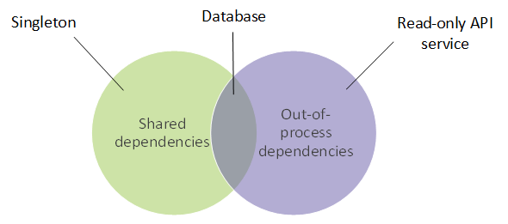
Notes:
The relation between shared and out-of-process dependencies. An example of a dependency that is shared but not out-of-process is a singleton (an instance that is reused by all tests) or a static field in a class. A database is shared and out-of-process — it resides outside the main process and is mutable. A read-only API is out-of-process but not shared, since tests can’t modify it and thus can’t affect each other’s execution flow.

Slide 41
To reiterate, the main difference between the classical and London schools is in how they treat the isolation issue in the definition of a unit test. This, in turn, spills over to the treatment of a unit — the thing that should be put under test — and the approach to handling dependencies.
As I mentioned previously, I prefer the classical school of unit testing. It tends to produce tests of higher quality and thus is better suited for achieving the ultimate goal of unit testing, which is the sustainable growth of your project. The reason is fragility: tests that use mocks tend to be more brittle than classical tests (more on this in chapter 5). For now, let’s take the main selling points of the London school and evaluate them one by one.

Slide 42
The London school’s approach provides the following benefits:
Better granularity. The tests are fine grained and check only one class at a time.
It’s easier to unit test a larger graph of interconnected classes. Since all collaborators are replaced by test doubles, you don’t need to worry about them at the time of writing the test.
If a test fails, you know for sure which functionality has failed. Without the class’s collaborators, there could be no suspects other than the class under test itself. Of course, there may still be situations where the system under test uses a value object and it’s the change in this value object that makes the test fail. But these cases aren’t that frequent because all other dependencies are eliminated in tests.

Slide 43
TEST-DRIVEN DEVELOPMENT
Test-driven development is a software development process that relies on tests to drive the project development. The process consists of three (some authors specify four) stages, which you repeat for every test case:
Write a failing test to indicate which functionality needs to be added and how it should behave.
Write just enough code to make the test pass. At this stage, the code doesn’t have to be elegant or clean.
Refactor the code. Under the protection of the passing test, you can safely clean up the code to make it more readable and maintainable.
Notes:
Good sources on this topic are the two books I recommended earlier: Kent Beck’s Test-Driven Development: By Example and Growing Object-Oriented Software, Guided by Tests by Steve Freeman and Nat Pryce.

Slide 44
refined the definition of a unit test
A unit test verifies a single unit of behavior,
Does it quickly,
And in isolation from other tests.

Slide 45
The isolation issue is disputed the most. The dispute led to the formation of two schools of unit testing: the classical (Detroit) school, and the London (mockist) school. This difference of opinion affects the view of what constitutes a unit and the treatment of the system under test’s (SUT’s) dependencies.
The London school states that the units under test should be isolated from each other. A unit under test is a unit of code, usually a class. All of its dependencies, except immutable dependencies, should be replaced with test doubles in tests.
The classical school states that the unit tests need to be isolated from each other, not units. Also, a unit under test is a unit of behavior, not a unit of code. Thus, only shared dependencies should be replaced with test doubles. Shared dependencies are dependencies that provide means for tests to affect each other’s execution flow.
Notes:
For a canonical book about the classical style, I recommend Kent Beck’s Test-Driven Development: By Example. For more on the London style, see Growing Object-Oriented Software, Guided by Tests, by Steve Freeman and Nat Pryce. For further reading about working with dependencies, I recommend Dependency Injection: Principles, Practices, Patterns by Steven van Deursen and Mark Seemann.

Slide 46
Integration tests

Slide 47
End-to-end tests are a subset of integration tests
In short, an integration test is a test that verifies that your code works in integration with shared dependencies, out-of-process dependencies, or code developed by other teams in the organization. There’s also a separate notion of an end-to-end test. End-to-end tests are a subset of integration tests. They, too, check to see how your code works with out-of-process dependencies. The difference between an end-to-end test and an integration test is that end-to-end tests usually include more of such dependencies.
The line is blurred at times, but in general, an integration test works with only one or two out-of-process dependencies. On the other hand, an end-to-end test works with all out-of-process dependencies, or with the vast majority of them. Hence the name end-to-end, which means the test verifies the system from the end user’s point of view, including all the external applications this system integrates with (see figure 2.6).

Slide 48
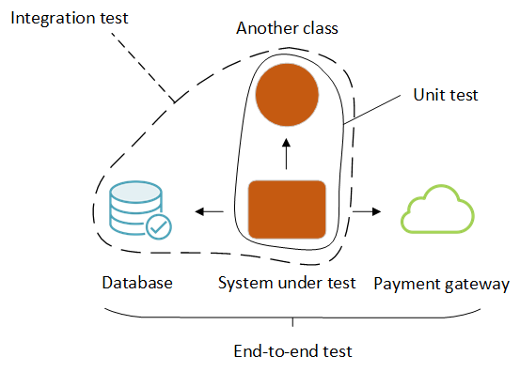
End-to-end tests normally include all or almost all out-of-process dependencies in the scope. Integration tests check only one or two such dependencies — those that are easier to set up automatically, such as the database or the file system.
Notes:
Let’s say your application works with three out-of-process dependencies: a database, the file system, and a payment gateway. A typical integration test would include only the database and file system in scope and use a test double to replace the payment gateway. That’s because you have full control over the database and file system, and thus can easily bring them to the required state in tests, whereas you don’t have the same degree of control over the payment gateway. With the payment gateway, you may need to contact the payment processor organization to set up a special test account. You might also need to check that account from time to time to manually clean up all the payment charges left over from the past test executions.
Since end-to-end tests are the most expensive in terms of maintenance, it’s better to run them late in the build process, after all the unit and integration tests have passed. You may possibly even run them only on the build server, not on individual developers' machines.
Keep in mind that even with end-to-end tests, you might not be able to tackle all of the out-of-process dependencies. There may be no test version of some dependencies, or it may be impossible to bring those dependencies to the required state automatically.
So you may still need to use a test double, reinforcing the fact that there isn’t a distinct line between integration and end-to-end tests.

Slide 49
The anatomy of a unit test

Slide 50
How to structure a unit test
Using the AAA pattern
The AAA pattern advocates for splitting each test into three parts: arrange, act, and assert. (This pattern is sometimes also called the 3A pattern.) Let’s take a Calculator class with a single method that calculates a sum of two numbers:

Slide 51
public class Calculator
{
public double Sum(double first, double second)
{
return first + second;
}
}
public class CalculatorTests
{
[Fact]
public void Sum_of_two_numbers()
{
// Arrange
double first = 10;
double second = 20;
var calculator = new Calculator();
// Act
double result = calculator.Sum(first, second);
// Assert
Assert.Equal(30, result);
}
}
Notes:
The AAA pattern provides a simple, uniform structure for all tests in the suite. This uniformity is one of the biggest advantages of this pattern: once you get used to it, you can easily read and understand any test. That, in turn, reduces maintenance costs for your entire test suite. The structure is as follows:
In the arrange section, you bring the system under test (SUT) and its dependencies to a desired state.
In the act section, you call methods on the SUT, pass the prepared dependencies, and capture the output value (if any).
In the assert section, you verify the outcome. The outcome may be represented by the return value, the final state of the SUT and its collaborators, or the methods the SUT called on those collaborators.

Slide 52
GIVEN-WHEN-THEN PATTERN
You might have heard of the Given-When-Then pattern, which is similar to AAA. This pattern also advocates for breaking the test down into three parts:
Given — Corresponds to the arrange section
When — Corresponds to the act section
Then — Corresponds to the assert section
Notes:
There’s no difference between the two patterns in terms of the test composition. The only distinction is that the Given-When-Then structure is more readable to non-programmers. Thus, Given-When-Then is more suitable for tests that are shared with non-technical people.

Slide 53
The natural inclination is to start writing a test with the arrange section. After all, it comes before the other two. This approach works well in the vast majority of cases, but starting with the assert section is a viable option too. When you practice Test-Driven Development (TDD) — that is, when you create a failing test before developing a feature — you don’t know enough about the feature’s behavior yet. So, it becomes advantageous to first outline what you expect from the behavior and then figure out how to develop the system to meet this expectation.
Such a technique may look counterintuitive, but it’s how we approach problem solving. We start by thinking about the objective: what a particular behavior should to do for us. The actual solving of the problem comes after that. Writing down the assertions before everything else is merely a formalization of this thinking process. But again, this guideline is only applicable when you follow TDD — when you write a test before the production code. If you write the production code before the test, by the time you move on to the test, you already know what to expect from the behavior, so starting with the arrange section is a better option.

Slide 54
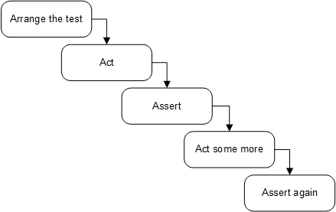
Avoid multiple arrange, act, and assert sections
Notes:
When you see multiple act sections separated by assert and, possibly, arrange sections, it means the test verifies multiple units of behavior. And, as we discussed in chapter 2, such a test is no longer a unit test but rather is an integration test. It’s best to avoid such a test structure. A single action ensures that your tests remain within the realm of unit testing, which means they are simple, fast, and easy to understand. If you see a test containing a sequence of actions and assertions, refactor it. Extract each act into a test of its own.
It’s sometimes fine to have multiple act sections in integration tests. As you may remember from the previous chapter, integration tests can be slow. One way to speed them up is to group several integration tests together into a single test with multiple acts and assertions. It’s especially helpful when system states naturally flow from one another: that is, when an act simultaneously serves as an arrange for the subsequent act.
But again, this optimization technique is only applicable to integration tests — and not all of them, but rather those that are already slow and that you don’t want to become even slower. There’s no need for such an optimization in unit tests or integration tests that are fast enough. It’s always better to split a multistep unit test into several tests.

Slide 55
Avoid if statements in tests
Notes:
Similar to multiple occurrences of the arrange, act, and assert sections, you may sometimes encounter a unit test with an if statement. This is also an anti-pattern. A test — whether a unit test or an integration test — should be a simple sequence of steps with no branching.
An if statement indicates that the test verifies too many things at once. Such a test, therefore, should be split into several tests. But unlike the situation with multiple AAA sections, there’s no exception for integration tests. There are no benefits in branching within a test. You only gain additional maintenance costs: if statements make the tests harder to read and understand.

Slide 56
How large should each section be?

Slide 57
The arrange section is the largest
The arrange section is usually the largest of the three. It can be as large as the act and assert sections combined. But if it becomes significantly larger than that, it’s better to extract the arrangements either into private methods within the same test class or to a separate factory class. Two popular patterns can help you reuse the code in the arrange sections: Object Mother and Test Data Builder.

Slide 58
Watch out for act sections that are larger than a single line
The act section is normally just a single line of code. If the act consists of two or more lines, it could indicate a problem with the SUT’s public API.

Slide 59
[Fact]
public void Purchase_succeeds_when_enough_inventory()
{
// Arrange
var store = new Store();
store.AddInventory(Product.Shampoo, 10);
var customer = new Customer();
// Act
bool success = customer.Purchase(store, Product.Shampoo, 5);
store.RemoveInventory(success, Product.Shampoo, 5);
// Assert
Assert.True(success);
Assert.Equal(5, store.GetInventory(Product.Shampoo));
}
[Fact]
public void Purchase_succeeds_when_enough_inventory()
{
// Arrange
var store = new Store();
store.AddInventory(Product.Shampoo, 10);
var customer = new Customer();
// Act
bool success = customer.Purchase(store, Product.Shampoo, 5);
// Assert
Assert.True(success);
Assert.Equal(5, store.GetInventory(Product.Shampoo));
}
Notes:
The issue with the new version is that it requires two method calls to perform a single operation. Note that this is not an issue with the test itself. The test still verifies the same unit of behavior: the process of making a purchase. The issue lies in the API surface of the Customer class. It shouldn’t require the client to make an additional method call.
From a business perspective, a successful purchase has two outcomes: the acquisition of a product by the customer and the reduction of the inventory in the store. Both of these outcomes must be achieved together, which means there should be a single public method that does both things. Otherwise, there’s a room for inconsistency if the client code calls the first method but not the second, in which case the customer will acquire the product but its available amount won’t be reduced in the store.
Such an inconsistency is called an invariant violation. The act of protecting your code against potential inconsistencies is called encapsulation. When an inconsistency penetrates into the database, it becomes a big problem: now it’s impossible to reset the state of your application by simply restarting it. You’ll have to deal with the corrupted data in the database and, potentially, contact customers and handle the situation on a case-by-case basis. Just imagine what would happen if the application generated confirmation receipts without actually reserving the inventory. It might issue claims to, and even charge for, more inventory than you could feasibly acquire in the near future.

Slide 60
How many assertions should the assert section hold?
Notes:
Finally, there’s the assert section. You may have heard about the guideline of having one assertion per test. It takes root in the premise discussed in the previous chapter: the premise of targeting the smallest piece of code possible.
As you already know, this premise is incorrect. A unit in unit testing is a unit of behavior, not a unit of code. A single unit of behavior can exhibit multiple outcomes, and it’s fine to evaluate them all in one test.
Having that said, you need to watch out for assertion sections that grow too large: it could be a sign of a missing abstraction in the production code. For example, instead of asserting all properties inside an object returned by the SUT, it may be better to define proper equality members in the object’s class. You can then compare the object to an expected value using a single assertion.

Slide 61
Reusing test fixtures between tests
It’s important to know how and when to reuse code between tests. Reusing code between arrange sections is a good way to shorten and simplify your tests, and this section shows how to do that properly.
A test fixture is an object the test runs against. This object can be a regular dependency — an argument that is passed to the SUT. It can also be data in the database or a file on the hard disk. Such an object needs to remain in a known, fixed state before each test run, so it produces the same result. Hence the word fixture.

Slide 62
The first — incorrect — way to reuse test fixtures is to initialize them in the test’s constructor (or the method marked with a [SetUp] attribute if you are using NUnit), as shown next.
public class CustomerTests
{
private readonly Store _store;
private readonly Customer _sut;
public CustomerTests()
{
_store = new Store();
_store.AddInventory(Product.Shampoo, 10);
_sut = new Customer();
}
[Fact]
public void Purchase_succeeds_when_enough_inventory()
{
bool success = _sut.Purchase(_store, Product.Shampoo, 5);
Assert.True(success);
Assert.Equal(5, _store.GetInventory(Product.Shampoo));
}
[Fact]
public void Purchase_fails_when_not_enough_inventory()
{
bool success = _sut.Purchase(_store, Product.Shampoo, 15);
Assert.False(success);
Assert.Equal(10, _store.GetInventory(Product.Shampoo));
}
}
Notes:
The two tests in listing 3.7 have common configuration logic. In fact, their arrange sections are the same and thus can be fully extracted into CustomerTests's constructor — which is precisely what I did here. The tests themselves no longer contain arrangements.
With this approach, you can significantly reduce the amount of test code — you can get rid of most or even all test fixture configurations in tests. But this technique has two significant drawbacks:
It introduces high coupling between tests.
It diminishes test readability.

Slide 63
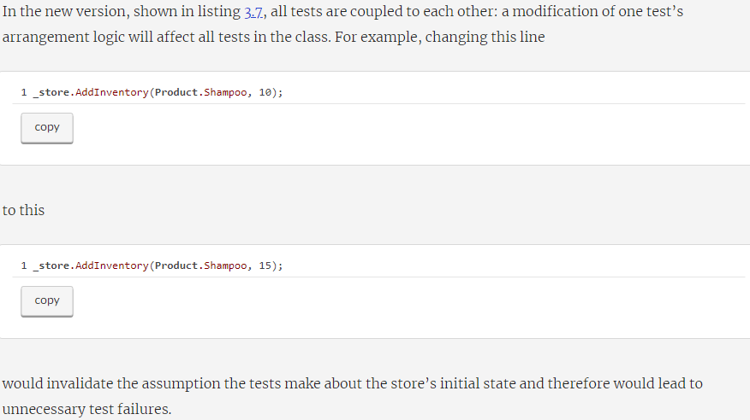
High coupling between tests is an anti-pattern
Notes:
That’s a violation of an important guideline: a modification of one test should not affect other tests. This guideline is similar to what we discussed in chapter 2 — that tests should run in isolation from each other. It’s not the same, though. Here, we are talking about independent modification of tests, not independent execution. Both are important attributes of a well-designed test.

Slide 64
The use of constructors in tests diminishes test readability
The other drawback to extracting the arrangement code into the constructor is diminished test readability. You no longer see the full picture just by looking at the test itself. You have to examine different places in the class to understand what the test method does.
Even if there’s not much arrangement logic — say, only instantiation of the fixtures — you are still better off moving it directly to the test method. Otherwise, you’ll wonder if it’s really just instantiation or something else is being configured there, too. A self-contained test doesn’t leave you with such uncertainties.

Slide 65
A better way to reuse test fixtures
The use of the constructor is not the best approach when it comes to reusing test fixtures. The second way — the beneficial one — is to introduce private factory methods in the test class, as shown in the following listing. public class CustomerTests
{
[Fact]
public void Purchase_succeeds_when_enough_inventory()
{
Store store = CreateStoreWithInventory(Product.Shampoo, 10);
Customer sut = CreateCustomer();
bool success = sut.Purchase(store, Product.Shampoo, 5);
Assert.True(success);
Assert.Equal(5, store.GetInventory(Product.Shampoo));
}
[Fact]
public void Purchase_fails_when_not_enough_inventory()
{
Store store = CreateStoreWithInventory(Product.Shampoo, 10);
Customer sut = CreateCustomer();
bool success = sut.Purchase(store, Product.Shampoo, 15);
Assert.False(success);
Assert.Equal(10, store.GetInventory(Product.Shampoo));
}
private Store CreateStoreWithInventory(
Product product, int quantity)
{
Store store = new Store();
store.AddInventory(product, quantity);
return store;
}
private static Customer CreateCustomer()
{
return new Customer();
}
}
Notes:
By extracting the common initialization code into private factory methods, you can also shorten the test code, but at the same time keep the full context of what’s going on in the tests. Moreover, the private methods don’t couple tests to each other as long as you make them generic enough. That is, allow the tests specify how they want the fixtures be created.

Slide 66
Look at this line, for example:
Store store = CreateStoreWithInventory(Product.Shampoo, 10);
Notes:
The test explicitly states that it wants the factory method to add 10 units of shampoo to the store. This is both highly readable and reusable. It’s readable because you don’t need to examine the internals of the factory method to understand the attributes of the created store. It’s reusable because you can utilize this method in other tests, too.
Note that in this particular example, there’s no need to introduce factory methods, as the arrangement logic is quite simple. View it merely as a demonstration.

Slide 67
There’s one exception to this rule of reusing test fixtures. You can instantiate a fixture in the constructor if it’s used by all or almost all tests. This is often the case for integration tests that work with a database. All such tests require a database connection, which you can initialize once and then reuse everywhere. But even then, it would make more sense to introduce a base class and initialize the database connection in that class’s constructor, not in individual test classes. public class CustomerTests : IntegrationTests
{
[Fact]
public void Purchase_succeeds_when_enough_inventory()
{
/* use _database here */
}
}
public abstract class IntegrationTests : IDisposable
{
protected readonly Database _database;
protected IntegrationTests()
{
_database = new Database();
}
public void Dispose()
{
_database.Dispose();
}
}
Notes:
Notice how CustomerTests remains constructor-less. It gets access to the _database instance by inheriting from the IntegrationTests base class.

Slide 68
Naming a unit test
[MethodUnderTest]_[Scenario]_[ExpectedResult]
MethodUnderTest is the name of the method you are testing.
Scenario is the condition under which you test the method.
ExpectedResult is what you expect the method under test to do in the current scenario.
Notes:
It’s important to give expressive names to your tests. Proper naming helps you understand what the test verifies and how the underlying system behaves.
So, how should you name a unit test? I’ve seen and tried a lot of naming conventions over the past decade. One of the most prominent, and probably least helpful, is the following convention:
[MethodUnderTest]_[Scenario]_[ExpectedResult]
where
MethodUnderTest is the name of the method you are testing.
Scenario is the condition under which you test the method.
ExpectedResult is what you expect the method under test to do in the current scenario.

Slide 69
Unit test naming guidelines
Don’t follow a rigid naming policy. You simply can’t fit a high-level description of a complex behavior into the narrow box of such a policy. Allow freedom of expression.
Name the test as if you were describing the scenario to a non-programmer who is familiar with the problem domain. A domain expert or a business analyst is a good example.
Separate words with underscores. Doing so helps improve readability, especially in long names.

Slide 70
Example: Renaming a test toward the guidelines
[Fact]
public void IsDeliveryValid_InvalidDate_ReturnsFalse()
{
DeliveryService sut = new DeliveryService();
DateTime pastDate = DateTime.Now.AddDays(-1);
Delivery delivery = new Delivery
{
Date = pastDate
};
bool isValid = sut.IsDeliveryValid(delivery);
Assert.False(isValid);
}
Notes:
Let’s take a test as an example and try to gradually improve its name using the guidelines I just outlined. In the following listing, you can see a test verifying that a delivery with a past date is invalid. The test’s name is written using the rigid naming policy that doesn’t help with the test readability.

Slide 71
public void Delivery_with_invalid_date_should_be_considered_invalid()
Notice two things in the new version:
The name now makes sense to a non-programmer, which means programmers will have an easier time understanding it, too.
The name of the SUT’s method — IsDeliveryValid — is no longer part of the test’s name.
Notes:
This test checks that DeliveryService properly identifies a delivery with an incorrect date as invalid. How would you rewrite the test’s name in plain English? The following would be a good first try:
The second point is a natural consequence of rewriting the test’s name in plain English and thus can be easily overlooked. However, this consequence is important and can be elevated into a guideline of its own.

Slide 72
WARNING
Don’t include the name of the SUT’s method in the test’s name.
Notes:
Remember, you don’t test code, you test application behavior. Therefore, it doesn’t matter what the name of the method under test is. As I mentioned previously, the SUT is just an entry point: a means to invoke a behavior. You can decide to rename the method under test to, say, IsDeliveryCorrect, and it will have no effect on the SUT’s behavior. On the other hand, if you follow the original naming convention, you’ll have to rename the test. This once again shows that targeting code instead of behavior couples tests to that code’s implementation details, which negatively affects the test suite’s maintainability. More on this issue in chapter 5.
The only exception to this guideline is when you work on utility code. Such code doesn’t contain business logic — its behavior doesn’t go much beyond simple auxiliary functionality and thus doesn’t mean anything to business people. It’s fine to use the SUT’s method names there.

Slide 73
public void Delivery_with_invalid_date_should_be_considered_invalid()
=>
public void Delivery_with_past_date_should_be_considered_invalid()
=>
public void Delivery_with_past_date_should_be_invalid()
=>
public void Delivery_with_past_date_is_invalid()
=>
public void Delivery_with_a_past_date_is_invalid()
Notes:
But let’s get back to the example. The new version of the test’s name is a good start, but it can be improved further. What does it mean for a delivery date to be invalid, exactly? From the test in listing 3.10, we can see that an invalid date is any date in the past. This makes sense — you should only be allowed to choose a delivery date in the future.
This is better but still not ideal. It’s too verbose. We can get rid of the word considered without any loss of meaning
The wording should be is another common anti-pattern. Earlier in this chapter I mentioned that a test is a single, atomic fact about a unit of behavior. There’s no place for a wish or a desire when stating a fact. Name the test accordingly — replace should be with is:
And finally, there’s no need to avoid basic English grammar. Articles help the test read flawlessly. Add the article a to the test’s name:

Slide 74

How we test?

Slide 75
https://stackoverflow.com/questions/29669393/override-default-spring-boot-application-properties-settings-in-junit-test
[Update: Overriding certain properties for testing]
Add src/main/resources/application-test.properties.
Annotate test class with @ActiveProfiles("test").
This loads application.properties and then application-test.properties properties into application context for the test case, as per rules defined here.
Conclusion: ActiveProfiles will append the properties file with the name of the property ex:@ActiveProfiles(”foobar") -> application- foobar.properties

